Slide 1
Lesson 1
复杂数据图写作技巧

Slide 2
目录
复杂动态图主体段分段方法
复杂动态图结构及句式范例/练习
复杂静态图主体段分段方法
复杂静态图结构及句式范例/练习
数据类图形总结段范例/练习
课后作业

Slide 3
目录
复杂动态图主体段分段方法
复杂动态图结构及句式范例/练习
复杂静态图主体段分段方法
复杂静态图结构及句式范例/练习
数据类图形总结段范例/练习
课后作业

Slide 4
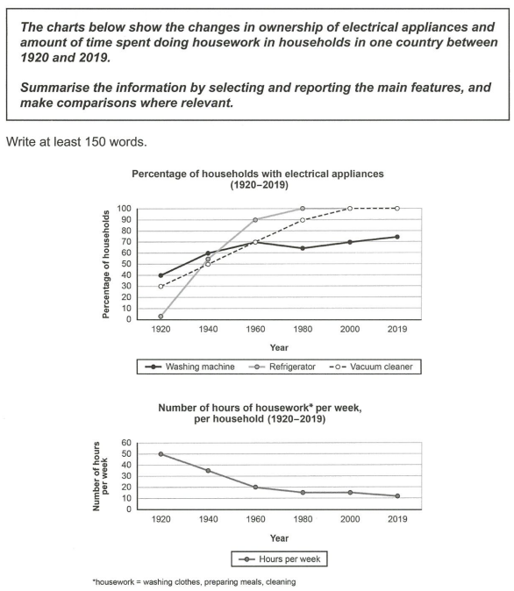
C16-T1
图一：家电拥有量
图二：家务时长
分段：一图一段

Slide 5
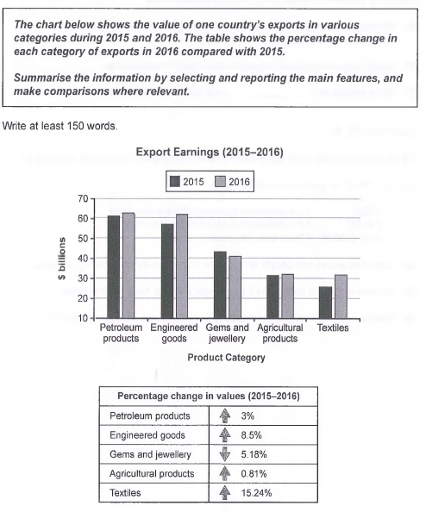
C14-T2
图一：五种出口商品收入(💲)
图二：五种出口商品收入的增长率（%）
分段：合二为一
a. 出口收入高的一段(PP + EG及这两项的增长率写一段)，
b. 出口收入低的一段(另外三项及他们的增长率写一段)

Slide 6
复杂动态图主体段分段方法
1. 两张图，且描述对象不同时：一图一段；
2. 两张图，描述对象相同但数据类型不同时：合二为一，再按趋势/数值大小分段

Slide 7
目录
复杂动态图主体段分段方法
复杂动态图结构及句式范例/练习
复杂静态图主体段分段方法
复杂静态图结构及句式范例/练习
数据类图形总结段范例/练习
课后作业

Slide 8
动态图复杂句式
1. 伴随状语：
a. 主语相同：主+ V1..., V2-ing ...
e.g. The export income from petroleum products was the highest during the period, increasing by 3% from 61 billion to roughly 63 billion dollars.
出口收入高的一段(PP + EG及这两项的增长率写一段)

Slide 9
动态图复杂句式
1. 伴随状语：
b. 主语不同：主1+ V1..., with + 主2 + V2-ing/ed ...
e.g. Petroleum products were the major source of the country’s foreign income during the period, with the amount of money earned increasing by 3% from 61 billion to roughly 63 billion dollars.
出口收入高的一段(PP + EG及这两项的增长率写一段)

Slide 10
动态图复杂句式
2. 定语从句: which
e.g. A more significant growth could be found in the export earnings from engineered goods, which rose by 8.5% from 57 billion to approximately 62 billion dollars.
出口收入高的一段(PP + EG及这两项的增长率写一段)

Slide 11
动态图复杂句式
2. 定语从句: when
e.g. The export earnings from engineered goods increased more significantly in 2016, when the amount rose by 8.5% to approximately 62 billion dollars.
出口收入高的一段(PP + EG及这两项的增长率写一段)

Slide 12
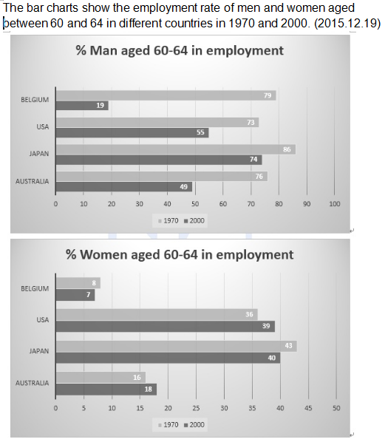
动态图复杂句式
2. 定语从句: where
e.g. In terms of women, the largest figure was in Japan, where the elderly employment rate decreased marginally from 43% to 40%.
43%
40%

Slide 13
动态图复杂句式
3. 分词作状语：Starting at ..., 主+ V ...
e.g. Starting at about 3% in 1920, the ownership of refrigerators increased sharply and exceeded that of washing machines in 1945.

Slide 14
动态图复杂句式
4. 介词：after/before+V-ing
e.g. In terms of housework, after plunging from 50 hours in 1920 to 20 hours in1960, the number declined slightly to 11 hours in 2019.
e.g. In terms of housework, the number of hours plunged from 50 to 20 during the first 4 decades, before declining slightly to 11 hours in 2019.

Slide 15
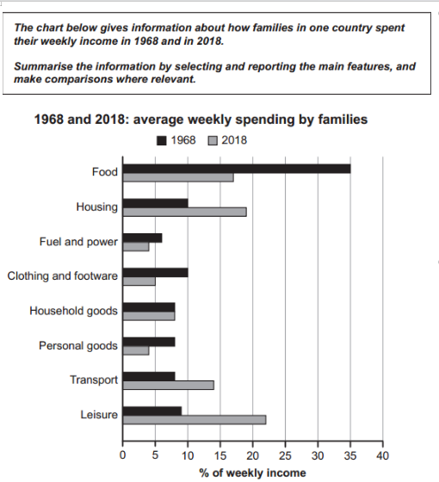
练习
1. 1968年，food每周花销的比例最高为35%，但是在2018年有一个骤降，那时百分比几乎降了一半至17%。
The percentage of weekly spending on
food was the highest in 1968 at 35%, but
there was a dramatic fall in 2018, when
the percentage almost halved to 17%.
C17-T3

Slide 16
练习
2. 相比之下，老年女性就业率在其他两个国家
(Belgium和Australia)低很多，Belgium的百分比
从8%降到了7%，Australia的百分比从16%涨到
了18%。(主1+ V1..., with + 主2 + V2-ing ...)
In comparison, the employment rates of elderly
women in the other two countries were much
lower, with the proportion in Belgium decreasing
from 8% to 7% and that in Australia increasing
from 16% to 18%.

Slide 17
目录
复杂动态图主体段分段方法
复杂动态图结构及句式范例/练习
复杂静态图主体段分段方法
复杂静态图结构及句式范例/练习
数据类图形总结段范例/练习
课后作业

Slide 18
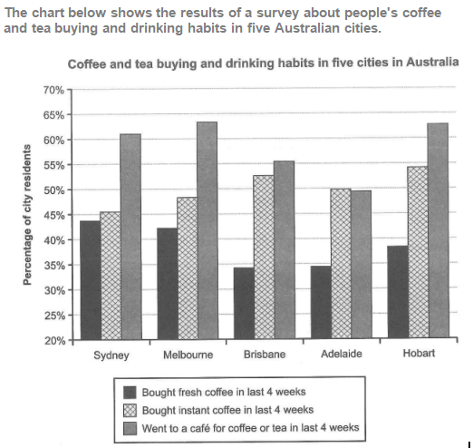
C15-T1
按图例分段：
a. went to cafe 一段
b. instant coffee 一段
c. fresh coffee 一段

Slide 19
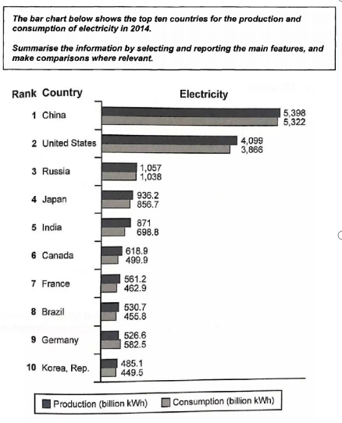
C13-T3
数值较大的国家一段（China + USA)
数值较小的国家一段（其余8个)

Slide 20
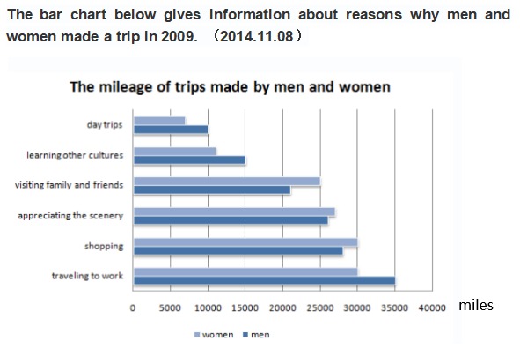
男>女的项目一段(work, cultures, day trips)
女>男的项目一段(shopping, scenery, visiting family)

Slide 21
复杂静态图主体段分段方法
1. 按图例分段
2. 数值较大的项目写一段，数值较小的项目写一段
3. A>B的项目写一段，B>A 的项目写一段

Slide 22
目录
复杂动态图主体段分段方法
复杂动态图结构及句式范例/练习
复杂静态图主体段分段方法
复杂静态图结构及句式范例/练习
数据类图形总结段范例/练习
课后作业

Slide 23
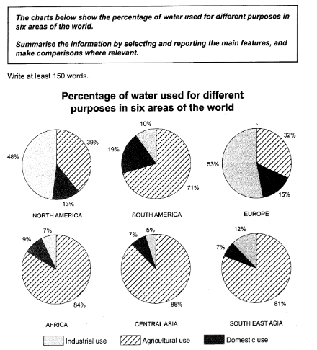
静态图复杂句式
1. 伴随状语：
a. 主语相同：主+ V1..., V2-ing ...
e.g. Water consumption for agricultural practice
in Central Asia is the highest, accounting
for 88%.
C11-T1

Slide 24
静态图复杂句式
1. 伴随状语：
b. 主语不同：主1+ V1..., with + 主2 + V2-ing/ed ...
e.g. Europe is the biggest consumer of water
in terms of industry(53%), with only 32% of water
used for agricultural purpose.
C11-T1

Slide 25
静态图复杂句式
2. 定语从句: where
e.g. In terms of industry, the largest figure is
in Europe, where 53% of water is used for this
purpose.
C11-T1

Slide 26
静态图复杂句式
3. ... (最大), followed by + 名词 + 定从
e.g. Europe ranks first in terms of water usage
for industrial production with 53%, followed by
North America where 48% of water is consumed
for the same purpose.
C11-T1

Slide 27
静态图复杂句式
4. ... , ranging from ... to ...
e.g. In comparison, the proportions of water
used for industry in the other four areas (South
America, Africa, Central Asia and South East Asia)
are significantly lower, ranging from 5% to 12%.
C11-T1

Slide 28
静态图复杂句式
5. ... (最大), as opposed to merely (最小)...
e.g. In terms of domestic use, the proportion of
water consumed in South America is the highest
at 19%, as opposed to merely 7% in Central Asia
and South East Asia.
C11-T1

Slide 29
练习
C15-T1
1. 就买instant coffee 而言，Hobart 拥有最大
比例的购买者（54.5%），其次是Brisbane,
在那里53%的居民保持这个习惯 。
In terms of buying instant coffee, Hobart
has the largest proportion of buyers (54.5%),
followed by Brisbane where 53% of residents
keep this habit.

Slide 30
练习
C15-T1
2. 相比之下，Adelaide, Melbourne和Sydney
购买instant coffee 的人数 比例略低，范围在
45.5%-50%之间。
By contrast, the proportions of instant coffee
buyers in Adelaide, Melbourne and Sydney
are slightly lower, ranging from 45.5% to 50%.

Slide 31
练习
C15-T1
3. 就买fresh coffee 而言，Sydney的购买者
比例最高为44.5%，而Brisbane只有34.5%。 。
In terms of buying fresh coffee, the largest
proportion of buyers is 44.5% in Sydney,
as opposed to merely 34.5% in Brisbane.

Slide 32
动态图总结段写法
① Overall, the year of 2016 witnessed an increase in the revenue from these categories of products except that from gems and jewellery. ② Moreover, it is noticeable that petroleum products and engineered goods were the two leading contributors to the country's foreign income over the period, in spite of a dramatic rise in textiles.

Slide 33
练习
① Overall, the 10 decades had witnessed a significant increase in the ownership of these three types of household appliances and a corresponding decrease in the time devoted to housework. ② Moreover, it is noticeable that refrigerators and vacuum cleaners had become household necessities since 1980 and 2000 respectively, although washing machines were the most popular in the first 25 years.

Slide 34
目录
复杂动态图主体段分段方法
复杂动态图结构及句式范例/练习
复杂静态图主体段分段方法
复杂静态图结构及句式范例/练习
数据类图形总结段范例/练习
课后作业

Slide 35
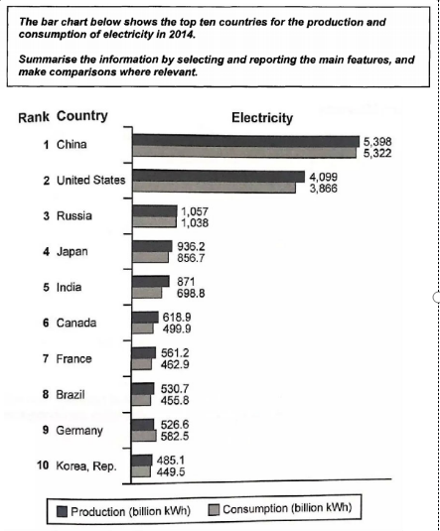
静态图总结段写法
总体比较，突出最值
1.除德国外，其他国家生产的电>消耗的电
2. 中国和美国两个数据值最高
① Overall, all these countries were self-sufficient in electricity except Germany, among which the US produced significant surplus electricity. ② Moreover, it is noticeable that China and the US were the two leading producers and users of electrical energy on the list.

Slide 36
练习
① Overall, the majority of residents in these cities prefer to go to a cafe for coffee or tea, except those in Adelaide who have a preference for instant coffee. ② Moreover, it is noticeable that fresh coffee buyers account for the smallest proportion in each city.

Slide 37
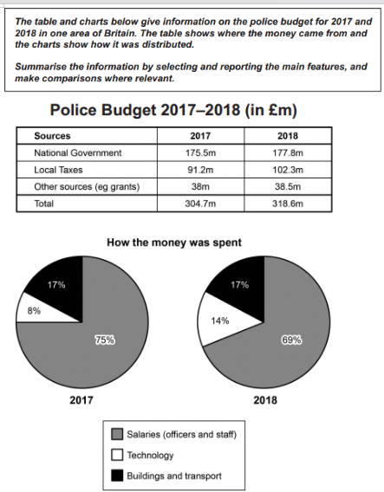
课后作业
C17-T2

